Slide 1

Jamestown-Scotland Ferry
VDOT Team 2
Chenlin Cheng, Eileanor LaRocco, Jeong Mo Yang, Bilun Zhang, Luigi Espinoza
Notes:
hello, welcome on board. We are VDOT team 2. My name is J Here is my teammates we will present on Jamestown ferry today

Slide 2
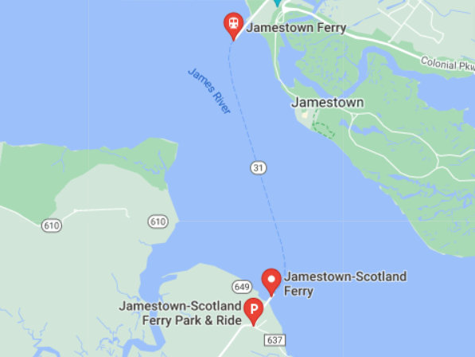
Agenda
Background
Business Problem
Data
Methodology
Results
Suggestions
Conclusion

Slide 3
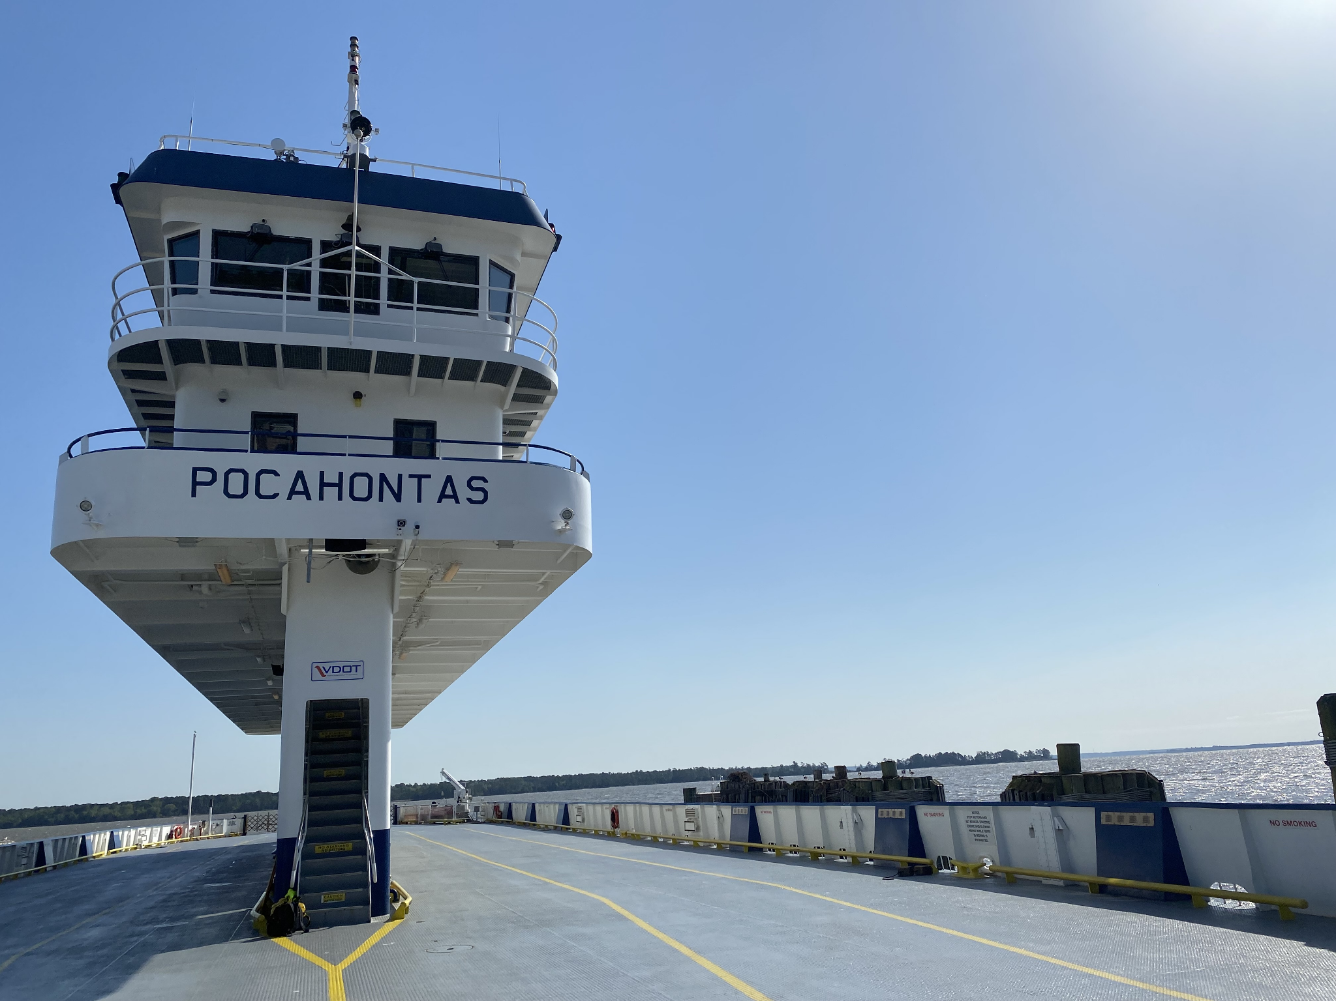
Background
Destination:
Jamestown to Scotland since 1945
Annually Budget:
$13 million
Ferries:
Pocahontas ~70 cars
Powhatan ~70 cars
Surry ~50 cars
Williamsburg ~50 cars
Notes:
The ferries run between J and S since 1945.There are 4 ferries and they can hold the cars size between 50 to 70. The ferries can transport cars, buses, trucks, pedestrians, and cyclists. It runs all day everyday. Jamestown ferry is the only 24-hour state-run ferry in Virginia.

Slide 4
Problem
Business Problem: Decrease vehicles left on dock (LOD) by either adding an additional ferry to meet demand or informing the public to take another route
Predict by hour the total traffic for the ferries in order to inform the public if they should take the ferry or another route
Predict spikes in traffic by day to allow the ferry company time to schedule additional ferries to accommodate the increased traffic
Notes:
First we predict total traffic by hour. The ferry traffic depends on the weather, holidays, special events, rush hours, weekdays, months, and other factors. In 2020, Covid is another feature need to think about.

Slide 5
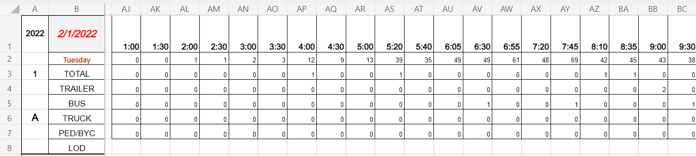
Excel Traffic Data
Notes:
Jamestown Ferry provided us with monthly excel files from January 2012 to March 2022. For most months, we received both a monthly report and daily traffic excel. For some of the years, a computing sheet was found within the traffic file. Each sheet for each month was formatted differently. For ease of data collection and accuracy we extracted data from the Daily Traffic sheet for the months between February 2014 and March 2022.
We aggregated all data for each trip which resulted in 170,398 rows of data. We aggregated by hour which reduced the dataset to about 70,000 rows

Slide 6
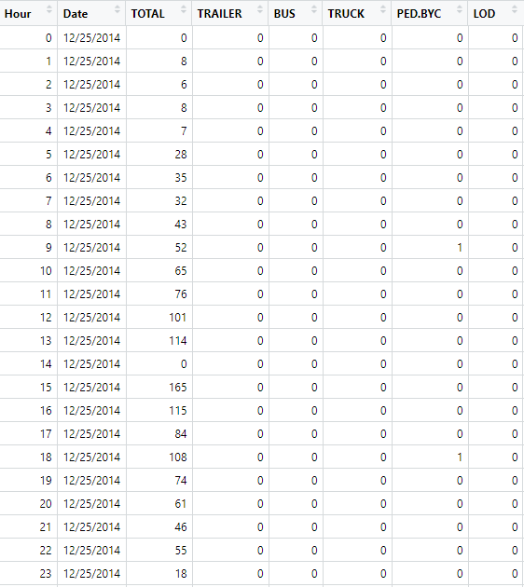
Transformed Traffic Data
Notes:
We wrote a python script to extract the onboarding vehicles, date, and hour data from the Daily Traffic excel sheet. We then cleaned and transposed the data using numpy and pandas. We later used Python’s os package to loop through our extraction code for each excel file and export a csv.

Slide 7
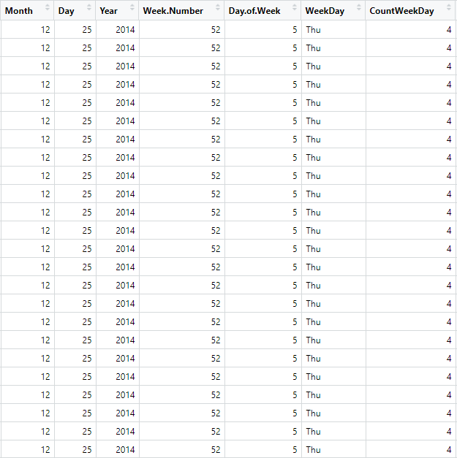
Date/Time Data
Notes:
To add additional predictive features, we expanded on the date. We split the date column into month (1-12), day(1-31), and year(2014-2022). We also expanded to additional columns for week number (1-52), day of the week (1-7), week day (Sun-Mon), and the count of the weekdays (1-5).

Slide 8
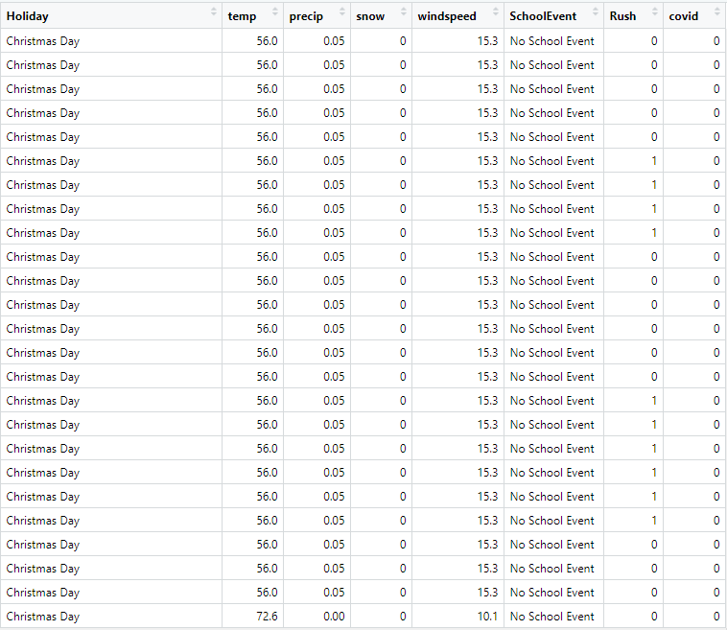
Additional Data
Notes:
We created a spreadsheet of dates of federal and state holidays for the past 8 years. This included holidays such as Memorial Day, Independence Day, Veterans Day, and Christmas Day, etc.
We downloaded weather data from the Visual Crossing weather data service for each day for the past eight years and extracted information on temperature, wind speed, snow, and precipitation.
We also created a spreadsheet of school events in the past 8 years such as spring break for both william and Mary and public schools, and William and Mary Graduation Weekend.

Slide 9
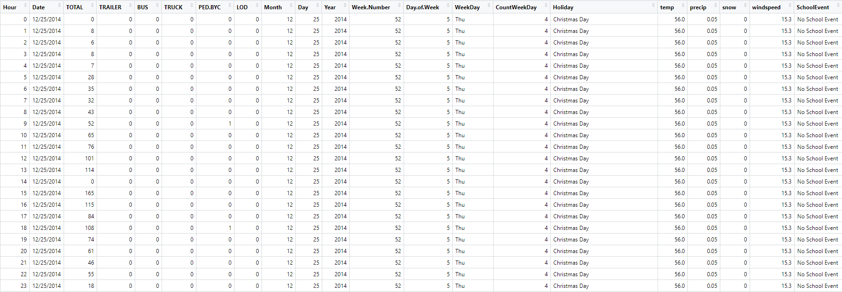
Final Data Set
Notes:
Here you can see our final data set used to create our model. We combined all the previous data sets and made this one.

Slide 10
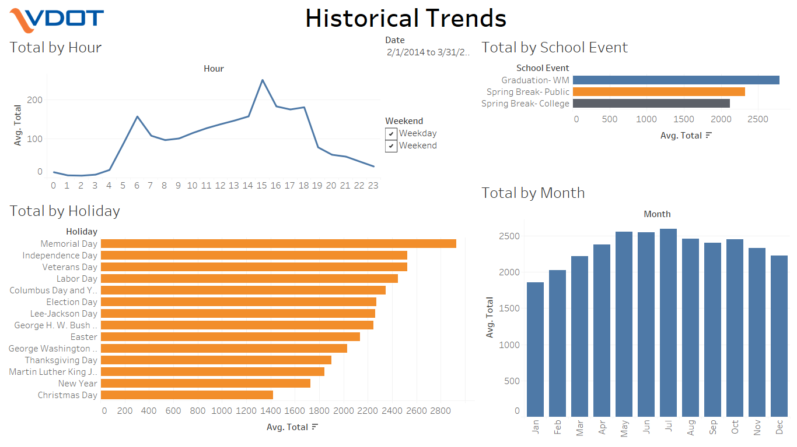
Data Exploration
Notes:
We did some preliminary data exploration in Tableau and found that on average the total number of passengers peaks at 6 am and 3 pm with averages of 157 and 251 passengers respectively. When looking at just weekdays, the data seems to follow a similar trend with peaks at both 6 am and 3 pm, but when looking at just weekends there is only a peak at 3pm. Over the last 8 years, there were between 172 to 5668 total vehicles daily with the average being 2378. The busiest months for the ferry are May, June, and July with all three averaging above 2500 passengers a day. When looking at holidays and events, we found that memorial day was by far the busiest holiday with an average of 2930 vehicles. Also, William & Mary Graduations are busier days for the ferry compared to spring breaks (Figure 4).

Slide 11
Initial Models
Time Series Model
Stationary assumption failed
Numerous factors affect the target variable
Multivariate Time Series: explain > predict
Holidays & School events occur different days each year
Multiple Linear Regression Model
Almost all variables are significant predictors
Linear Regression assumptions failed
Lower interpretability of the square root of total vehicles
Notes:
With the initial exploration of our dataset, we began to build a suitable model to predict the total number of vehicles for this ferry system. Because of the large time span of our selected dataset, the first feasible model that came to our mind was Time series. So Time series use historical data to infer the possibility of future changes. However, after preliminary analysis, we found that the dataset was not significantly stationary and there were numerous factors affecting the target variable other than just time. Therefore we thought about a multivariate time series model, although this model is theoretically feasible, the purpose is explaining more than predicting. And there are some holidays and school events occur different day each year, which also add difficulties to this model.
Then we considered multiple linear regression, which is basically a generalization of simple linear regression. However, the result shows that all variables are significant predictors, and it also failed the assumption check of linear regression. Since our predicted model is highly skewed, we also tried transformation of target variable and made the number square root of it. The model gave much better results, but it's kind of meaningless to interpret. Like we cannot say the future total number is square root of something.

Slide 12
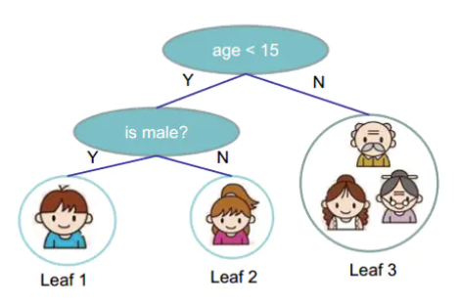
XGBoost
An optimized distributed gradient boosting algorithm
Efficient, flexible
Mapping between feature and label / result
Repeat same process till the best model selected.
Notes:
We landed on XGBoost in the end. XGBoost is an optimized distributed gradient boosting library designed to be more efficient and flexible. Let’s get started with a simple tree model, as the picture showed here. Basically you choose the answer by answering yes or no questions one by one, and classify all the observations you have. XGBoost is doing the same thing, mapping between features and labels, but repeat tons of times until the best model is selected.

Slide 13
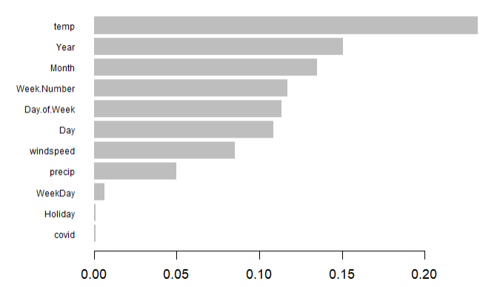
Prediction of High Traffic Days
XGBoost
Binary classification model
Predict unusually high traffic days
Temp is the most significant predictor
Notes:
So we start with a binary classification model to predict unusually high traffic days. For those days with total number of vehicles greater than 3000, we label it as a usually high traffic day, and the rest were normal days. The model shows temperature is the most significant predictor, and our target class is highly imbalanced

Slide 14
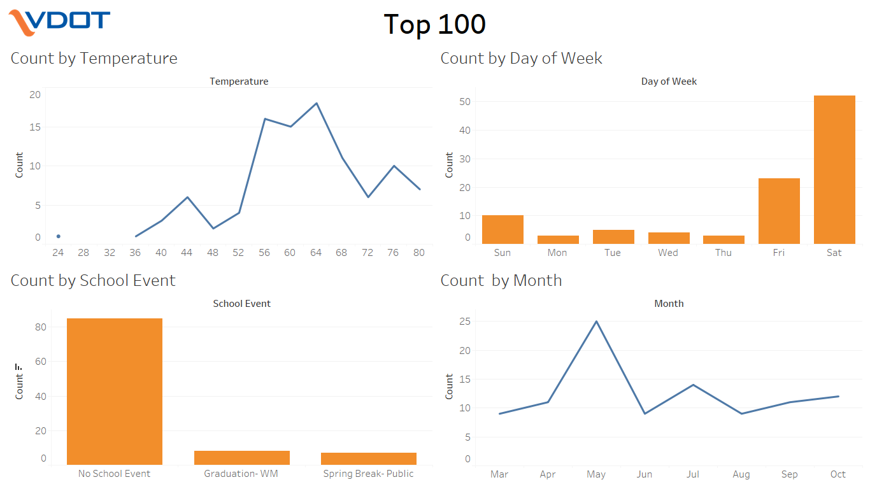
Features of Highest Traffic Days
Notes:
With the importance plot we just showed, we did this dashboard to show some relationship between important features of the top 100 days for total vehicles. From left to right, top to bottom, are temperature, day of week, school event, and month. So within these 100 days, we found many of days were Saturdays, in May, Memorial day, during Spring break for public school or graduation weekend for william and mary.

Slide 15
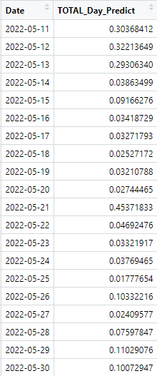
Daily Predictions
High Traffic Day
Notes:
So here is the predictions based on ‘unusually high traffic day model’. We predict by daily from May 11th to May 30, and the model gives that May 21st has a high probability to be a high traffic day, and please note that May 21 is our graduation day. Alright, I’ll pass it on to Eileanor for next model.

Slide 16
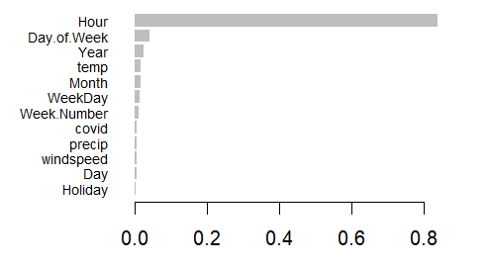
Predict Hourly Traffic
XGBoost
Regression model
Predict total number of vehicles on ferry per hour
MAE: 12.04
The predictions of test set were off on average by around 12 vehicles per hour
Hour is the most significant predictor
Notes:
Next we used an XGBoost regression model to predict the total number of vehicles on the ferry per hour.
Our model produced a mean absolute error of 12.4 which means that on average, the predictions of our test set were off by about 12 vehicles per hour- 12 vehicles higher or lower than the actual amount. We would expect around the same for our future predictions.
Graph shows the importance of the independent variables as predictors in our model. You can see that Hour is by far the most significant predictor of total vehicles by hour followed by the day of the week.
This makes intuitive sense because as we saw from our data, there were two rush hour peaks during weekdays and one peak during weekends.

Slide 17
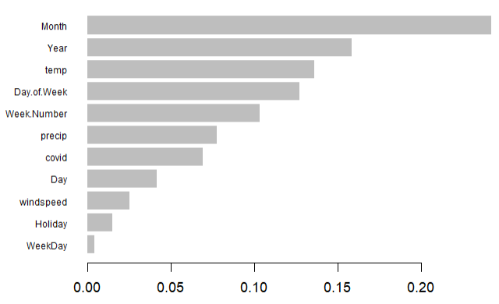
Hourly Prediction Variable Importance
Notes:
However, if we take out Hour from our model, month and temperature become the more important. As we saw with our historical data, there were more passengers in the summer months than in the winter and temperature is correlated with this.
Year is also important which could be correlated with covid as most of the year of 2021 is marked in our dataset as a covid date
Day of the week (weekdays vs weekends) we also saw a difference in the past data as well
Holidays do have some effect and more so than in our daily prediction model which could mean that the hourly patterns we tend to see are disrupted on these days
School events and snow did not contribute to the predictions so we took them out of our model. This could be due to the small number of data points for these features.
Even though we’ve tested our model on 20% of the historical data we were given that our model was not trained on, we wanted to create additional trust for our model’s performance by showing a side-by-side comparison of our model’s predicted values with data from last month which we did not have access to until a few days ago…

Slide 18
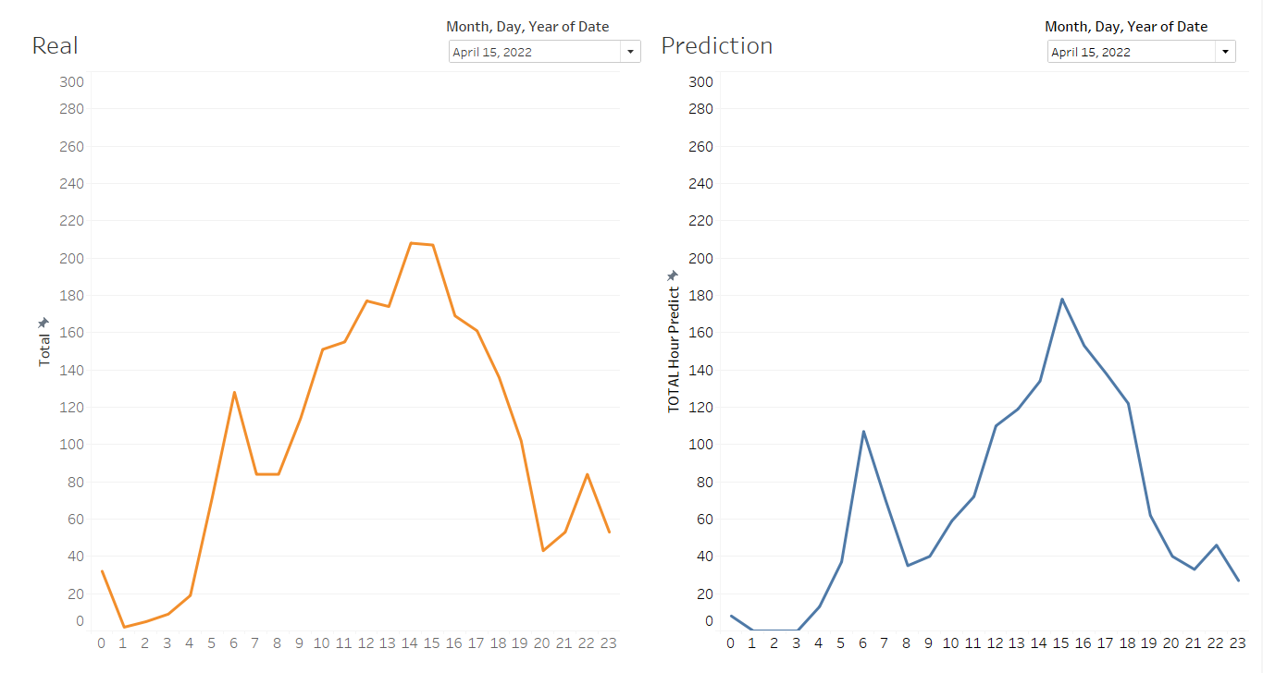
April Data Comparison
Notes:
the reason show our total size by hour is some difference because our metrics mae score is an average score. we focus on the trend. Easter is on 4/17 this year we can check that day to see the pattern.
15,17,23,6

Slide 19

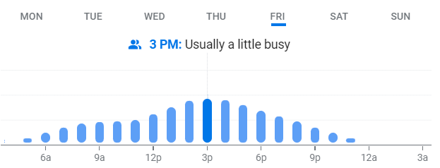
Google Prediction
Notes:
This is Google’s predictive model that shows up when you google the Jamestown Ferry.
While Google’s model shows similar trends to ours, theirs is more generalized, only showing relative levels of “business” averaged by day, our model is more detailed, predicting actual values of total vehicles up to 14 days in advance rather reliably

Slide 20
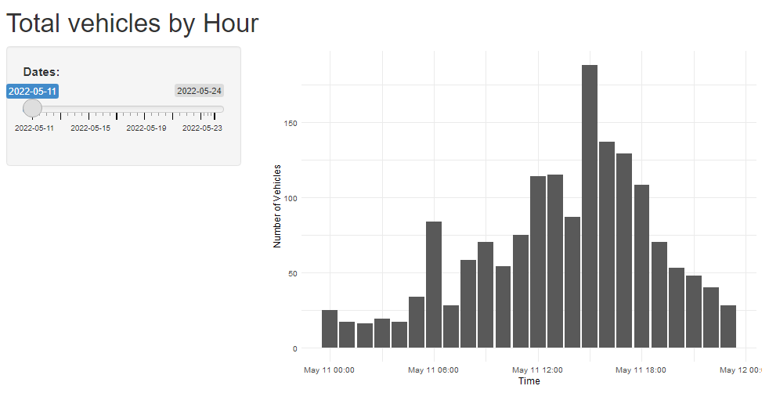
User Interface
R Shiny
User can select a date up to 14 days in advance of the current date
Bar chart of predicted vehicles per hour for the day
Notes:
We used R Shiny to create a user interface that allows for real time interaction with our model.
Through the interface, the user can select a date up to 14 days in advance of the current date and view a bar chart of predicted vehicles per hour for that day.
When accessed, predictive data for the next 14 days is created , the model is loaded, and the hourly vehicle numbers are predicted and visualized.
Demo it for you

Slide 21
Suggestions
Immediate Solution
Computing sheet is a good practice of data collection
Start and end time should be normalized to 00:00 as the start and 23:30 as the end
Should be in 30 minute increments
Format of the sheet should closely mimic the Transformed Traffic Data
Future Solution to Consider
Computer Vision Software
Great complement to already existing cameras by each departing decks
No room for human errors and convenient due to automated process of collecting data
Custom dashboards
Relatively low in price at $9 per channel per month when applied for annual subscription (Camlytics)

Slide 22

Demo
https://cloud.camlytics.com/?demo=1

Slide 23
Conclusion
XGBoost Model
Predict total load size per hour
Model with MAE of about 12
Visualized future prediction using R Shiny
3:00 PM is the busiest hour for the ferry
Two Models
General hourly trends
Days that will be higher traffic days
Reduce cars left on dock
Insight on days for additional ferry needed and hours of high traffic
Notes:
To sum everything up, the use of XGBoost allowed us to have a accurate model. Our MAE, being just above 12, meaning our model was only off by 12 cars plus-minus for every hour. Also, the model's ability to predict days that will be higher in traffic and hourly prediction together should reduce cars left on the dock. We also created a app using the Shiny package in R to visualize our model's predictions to provide intuitive insights into the possible traffic at a given hour of the day. As presented in previous slides, our model might not have done an excellent job of predicting the exact number of total vehicles. Nevertheless, we believe that it did an excellent job of portraying predicted patterns or trends of the traffic hourly in order to inform the public which hours they may want to avoid the ferry.

Slide 24
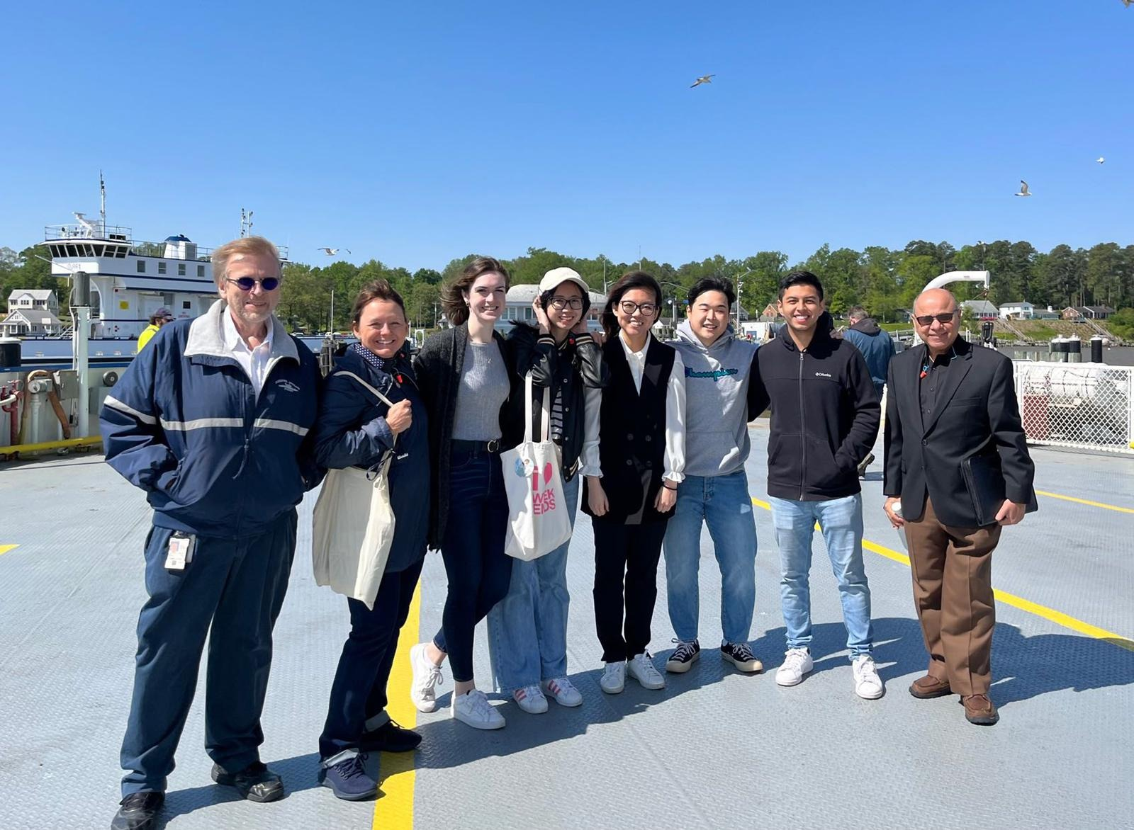
Thank You

